Slide 1
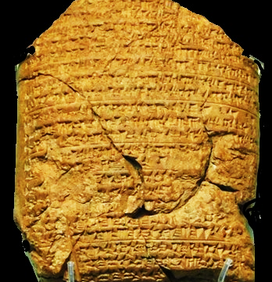
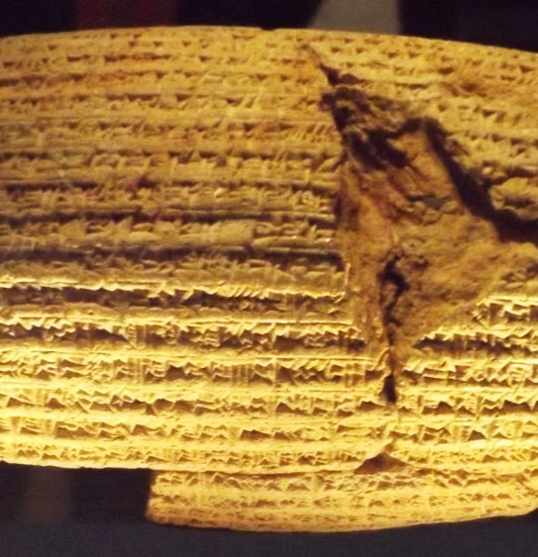
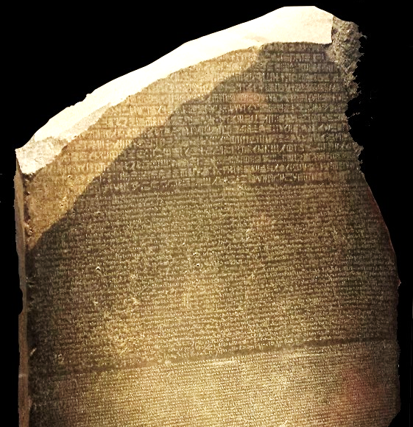
Captivity  Return  Years of Silence
Notes:
Three artifacts symbolizing the captivity, return, and years of silence.
This clay tablet from the Babylonian Chronicle (left) details major events in the Babylonian empire. Each year is separated by a line. This tablet records the exploits of Nebuchadnezzar from 605 to 594 BC, and specifically mentions taking captives and tribute from Jerusalem.
The Cyrus Cylindar (center, circa 530 B.C.) records the policy of Cyrus of Persia to allow captive nations to return to their homelands and rebuild the cities and temples. The Bible prophecies that Cyrus would do this 100 years before he was born (Isaiah 44:28).
The Rosetta Stone (right) is a granodiorite stele, found in 1799, inscribed with three versions of a decree issued at Memphis, Egypt, in 196 BC during the Ptolemaic dynasty on behalf of King Ptolemy V. The top and middle texts are in Ancient Egyptian using hieroglyphic script and demotic scripts, respectively, while the bottom is in Ancient Greek. As the decree has only minor differences between the three versions, the Rosetta Stone proved to be the key to deciphering Egyptian hieroglyphs, thereby opening a window into ancient Egyptian history.

Slide 2
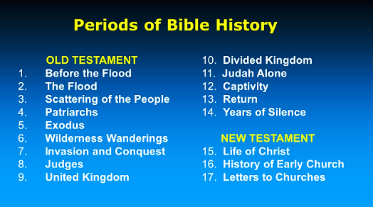

Slide 3
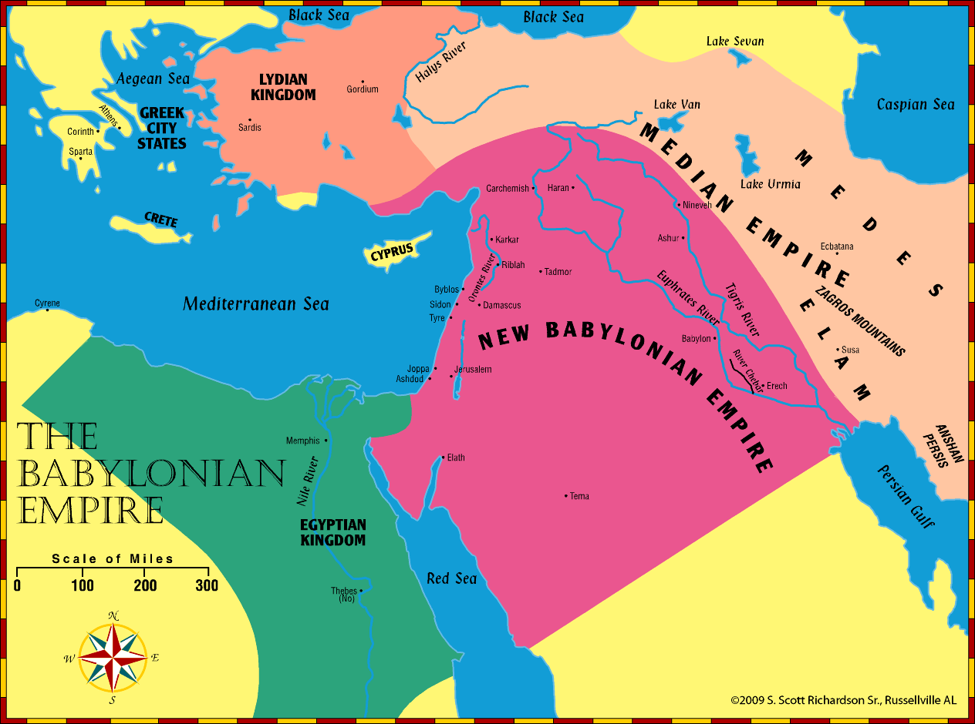
Jeremiah – Daniel – Ezekiel: Timeline (B.C.)
640
627
605
597
593
586
571
536
Daniel
Judah falls & Jerusalem is destroyed
Jeremiah
Ezekiel

Slide 4
Excerpts from the book of Ezekiel Psalm 137; Ezekiel 1:1-3:27
Overview of Ezekiel’s Message
Outline of the book of Ezekiel:
Chapters 1-24 -- Judgments against Judah and Jerusalem
Chapters 25-32 -- Judgments against the nations.
Chapters 33-48 -- God’s announcements of restoration and salvation.
Four primary objectives God had in mind for Ezekiel’s work:
To dispel any hope that the yoke of Babylon might soon be broken.
To present God’s case against Israel, to show how deeply they had sinned.
To help move His people to repentance.
To offer His people hope, to encourage them to turn to Him and to renew their efforts to serve Him.

Slide 5
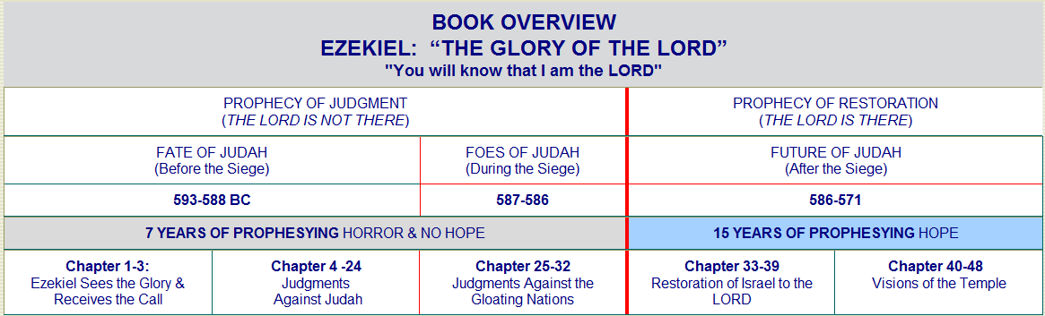

Slide 6
Excerpts from the book of Ezekiel Psalm 137; Ezekiel 1:1-3:27
Ezekiel the man
His name means “God strengthens” (Ezek. 2:3-5; 3:7-11).
He was born in 622 B.C. during the reign of Josiah and grew up in Judah.
He would have witnessed the first Jewish captives being taken off to Babylon in 605 B.C. by Nebuchadnezzar (Daniel 1:1-4).
He was 25 years old when taken into captivity (Ezek. 1:1-2).
This was 597 B.C. when Jehoiachin and 10,000 Jews were taken captive (2 Kings 24:10-16).
Five years later (592 B.C.) he was called to be a prophet and continued in that role until at least 570 B.C. (29:17).

Slide 7
Excerpts from the book of Ezekiel Psalm 137; Ezekiel 1:1-3:27
Ezekiel the man
Jerusalem fell six years after he began his work (586 B.C.)
Afterwards, Ezekiel’s prophecies focused on assurance and hope for Israel’s future.
Ezekiel was a married man (24:15-18)
Ezekiel was a contemporary of both Jeremiah and Daniel.
Jeremiah was 20+ years older than both Ezekiel and Daniel. He prophesied in Jerusalem from 626 to 586+ B.C.
Daniel was in the first group of captives taken to Babylon, where he lived and prophesied from 605 to 536 B.C.
Ezekiel dwelt in Tel-Abib (Hill of Corn Ears) near the river Chebar.

Slide 8
Jeremiah (priest)
Judah
Jerusalem
Justice is coming
Judgement is coming
Josiah king when he began
Began in 626 BC
Prophesied 40 years

Slide 9
Daniel
Dreams of Nebuchadnezzar
Delicacies
Dainties
Darius
Den of lions
Taken captive in 606 B.C.

Slide 10
Ezekiel (priest)
Exile
Everyday people
Explaining why
Egypt will fall
Edom desolate
Taken captive in 597 B.C.

Slide 11
Excerpts from the book of Ezekiel Psalm 137; Ezekiel 1:1-3:27
Historical Setting of the Prophecy (Ezekiel 1:1-3)
The Time:
Ezekiel was 30 years old.
He was a priest (1:3; Numbers 4:3).
He had been in captivity 5 years (Jehoiachin was captured in 597 B.C).
The Place:
By the river Chebar, a canal linking Babylon to the Euphrates (Ps. 137).
In the community of Tel Abib.
The Occasion: “The word of the Lord came expressly to Ezekiel the priest” (cf. 2 Peter 1:20-21).

Slide 12
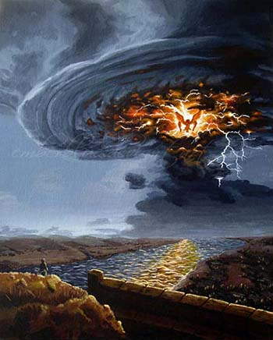
EZEKIEL 1:4-5
Ezekiel sees “a whirlwind was coming out of the north, a great cloud with raging fire engulfing itself; and brightness was all around it and radiating out of its midst like the color of amber, out of the midst of the fire. Also from within it came the likeness of four living creatures…”

Slide 13

Excerpts from the book of Ezekiel (Psalm 137; Ezekiel 1:1-3:27)
Visions of Glory of the Lord Coming in Judgment (Ezekiel 1:4-28)
Four living creatures come from the midst of the storm.
These are later identified as Cherubim (Ezekiel 10:15-20).
Consistently in Scripture, cherubim are guardians to the presence of God (Gen. 3:24; Exo. 25:18-22; 36:35; 2 Kings 19:15)

Slide 14
Excerpts from the book of Ezekiel Psalm 137; Ezekiel 1:1-3:27
Notable aspects of the Cherubim
Each had four faces:
Man (intelligence) - Lion (strength) - Ox (service) - Eagle (swiftness)
Their appearance and movement like lightning suggests the power and instantaneous speed with which they perform their duties.
Because they are so similar to the creatures described in John’s vision of the throne scene of God in Revelation 6:6-11, they are usually identified as the same beings.

Slide 15
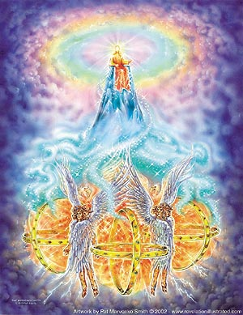
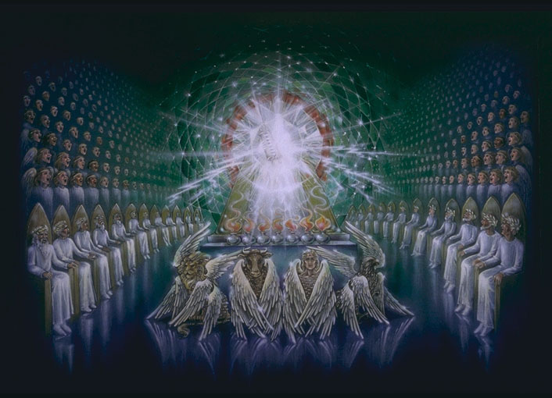
The Throne Scenes of Ezekiel 1 & Revelation 4
The two scenes share several common images – both have four multi-winged creatures before a bright throne of One who is worshiped. Each vision includes a number of things that the other does not.

Slide 16
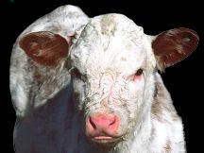
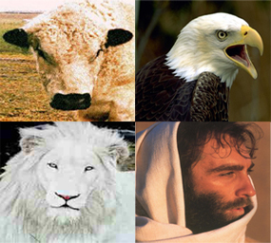
Four Living Creatures Ezekiel 1 & Revelation 4
In Revelation, the creatures have one visage each – the first like a lion, the second like a calf, the third like a man and the fourth like and eagle.
The creatures in Ezekiel each have four faces like a man, a lion, an ox and an eagle.

Slide 17
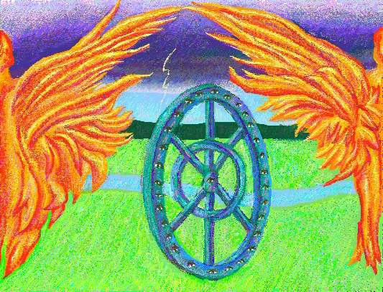
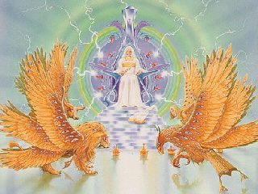
In Ezekiel, the creatures are accompanied by wheels full of eyes (omniscience) which enabled them to go “wherever the spirit wanted to go” (omnipresence).
In Revelation, each creature has is full of eyes, suggesting complete omniscience.

Slide 18

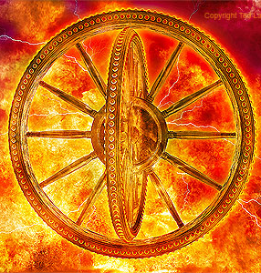
The Vision of the Chariot (1:15-25)
Each cherub has a wheel
Each wheel is a wheel within a wheel (1:16)
The design of the wheels suggests omniscience and the ability to move in any direction (1:17-18)
Each cherub and wheel work as a unit (1:19)
The spirit of the cherubim directs the wheels (1:20-21)
Over the heads of the cherubim is a great expanse. When the cherubim moved it sounded like many waters, the Almighty, and an army (1:22-24)
In response to a voice from above them, the cherubim let down their wings and become still (1:25)

Slide 19
Excerpts from the book of Ezekiel Psalm 137; Ezekiel 1:1-3:27
Visions of Glory of the Lord Coming in Judgment (Ezekiel 1:4-28)
The Throne of the Lord’s Glory (1:26-28)
Ezekiel sees a throne above the expanse above the cherubim.
The throne was like sapphire. The one sitting on the throne was human in appearance (1:26)
From the waist up, His appearance was like glowing amber metal, and from the waist down it was like fire (1:27)
Surrounding the scene was a glow like a bright rainbow. (1:28)
“This was the appearance of the likeness of the glory of the LORD. So when I saw it, I fell on my face, and I heard a voice of One speaking.”

Slide 20
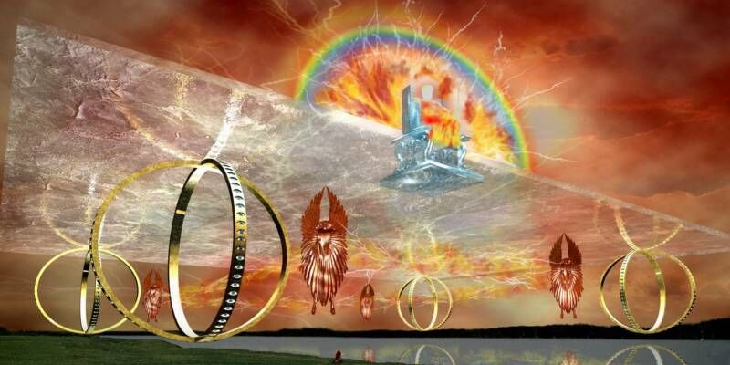
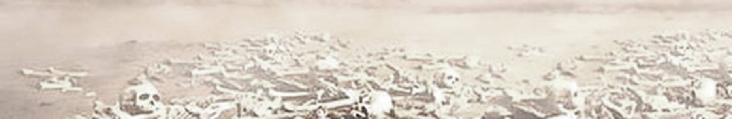
Ezekiel Lesson 2: Ezekiel 1:1-28
Visions of Glory of the Lord Coming in Judgment (1:4-28)
The Vision of the Chariot (1:15-25)
Each cherub has a wheel
Each wheel is a wheel within a wheel (1:16)
The design of the wheels suggests omniscience
and the ability to move in any direction (1:17-18)
The cherubim and wheel worked as a unit (1:19)
The spirit of the cherubim directs the wheels
The wheels are full of eyes.

Slide 21
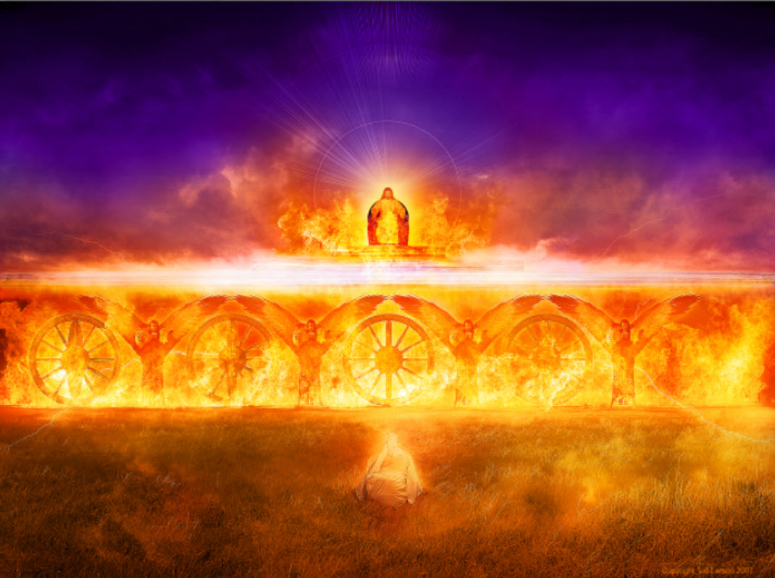

Slide 22
Excerpts from the book of Ezekiel Psalm 137; Ezekiel 1:1-3:27
God’s spirit enters Ezekiel (2:1-2; 2 Peter 1:20-21)
Ezekiel is charged with speaking the word of the Lord to stubborn and rebellious children (2:3-7)
He is to declare, “thus says the Lord God” (2:4)
When Ezekiel is through, “They will know that a prophet has been among them” (2:5)
He is to declare God’s word in spite of the painful difficulties and defiance he will face (2:6-7)

Slide 23
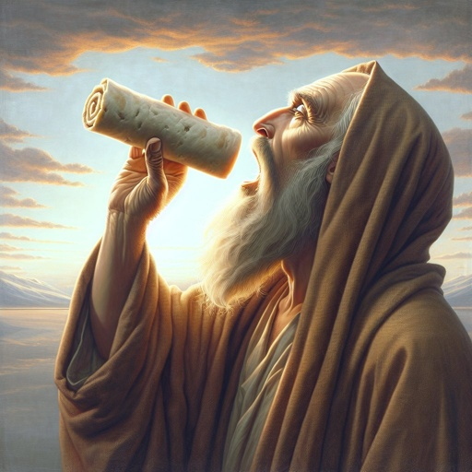
Excerpts from the book of Ezekiel Psalm 137; Ezekiel 1:1-3:27
Ezekiel eats the scroll (2:8—3:3)
He is admonished to not be rebellious, but readily receive the words of God (2:8-10)
He is caused to eat the scroll, taking God’s word within Him so that he might speak it to Israel (3:1-2)
He finds it sweet to his taste (3:3; Psalm 19:10; 119:103; Jer. 15:16; Rev. 10:9-10)
Notes:
Psalms 19:10 More to be desired are they than gold, Yea, than much fine gold; Sweeter also than honey and the honeycomb.
Psalms 119:103 How sweet are Your words to my taste, Sweeter than honey to my mouth!
Jeremiah 15:16 Your words were found, and I ate them, And Your word was to me the joy and rejoicing of my heart; For I am called by Your name, O LORD God of hosts.

Slide 24
Excerpts from the book of Ezekiel Psalm 137; Ezekiel 1:1-3:27
Ezekiel is commissioned to speak God’s word in the face of opposition (3:4-15)
Language will not be a barrier to Ezekiel’s work, but attitudes will be! (3:4-7)
Strangers and foreigners would have been more receptive to God’s word than God’s own people.
The Lord had made Ezekiel “adamant” and hard enough to confront Israel’s hard-hearted rebellion (3:8-9; compare Jeremiah 1:18)
ADAMANT: “a legendary rock or mineral…formerly associated with diamond”
“Unshakable or insistent especially in maintaining a position or opinion: unyielding” (Webster’s online Dictionary)
Notes:
Jeremiah 1:18 For, behold, I have made thee this day a fortified city, and an iron pillar, and brazen walls, against the whole land, against the kings of Judah, against the princes thereof, against the priests thereof, and against the people of the land.

Slide 25

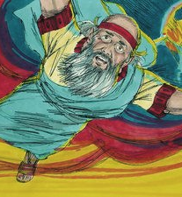
Ezekiel is to speak God’s word in the face of opposition (3:4-15)
Ezekiel is told to receive God’s word and speak it to the captives whether they hear or not (3:10-11).
Ezekiel is transported by the Spirit to the captives at Tel Abib “and remained there astonished among them seven days” (3:12-15).

Slide 26
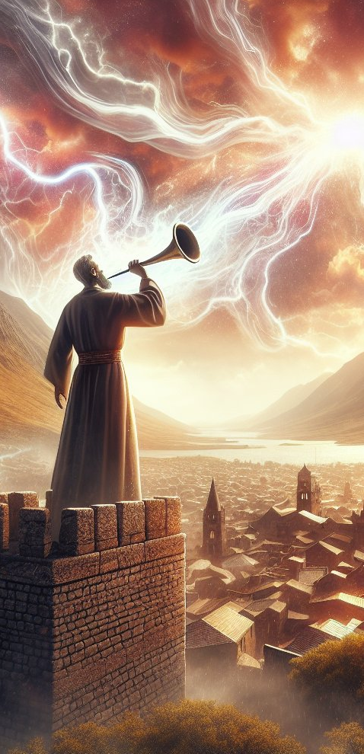
Excerpts from the book of Ezekiel Psalm 137; Ezekiel 1:1-3:27
A watchman’s duty is to warn (3:16-17)
He must warn both the wicked and the erring righteous; in doing so he saves his own soul (3:18-21; Acts 20:26-27; 1 Timothy 4:16)
If he fails to do so, God will require of him the blood of those whom he failed to warn!
A righteous man can turn to sin! Those who see it must warn him! (James 5:19-20)
The “stumbling block” put before the righteous man may be a truth that he does not accept (1 Peter 2:7-8)
Israel would limit Ezekiel’s work, but he would speak or not as God directed (3:22-27)
Notes:
Acts 20:26-27 Therefore I testify to you this day that I am innocent of the blood of all men. 27 For I have not shunned to declare to you the whole counsel of God.
1 Timothy 4:16 Take heed to yourself and to the doctrine. Continue in them, for in doing this you will save both yourself and those who hear you.
James 5:19-20 Brethren, if anyone among you wanders from the truth, and someone turns him back, 20 let him know that he who turns a sinner from the error of his way will save a soul from death and cover a multitude of sins.
1 Peter 2:7-8 Therefore, to you who believe, He is precious; but to those who are disobedient, "THE STONE WHICH THE BUILDERS REJECTED HAS BECOME THE CHIEF CORNERSTONE," 8 and "A STONE OF STUMBLING AND A ROCK OF OFFENSE." They stumble, being disobedient to the word, to which they also were appointed.

Slide 27
